Slide 1
COMP 224/INTE 216
COMPUTER ORGANIZATION AND ARCHITECTURE
LECTURE ONE
INTRODUCTION
OMBUYA D.O.

Slide 2
WELCOME
WE WILL START IN FEW MINUTES..

Slide 3
Devotional Meditation
Proverbs 18:15
The heart of the prudent getteth knowledge; and the ear of the wise seeketh knowledge.

Slide 4
Lecture Outline
Introduction
Breackdown of computer Architecture
Understanding Computer Organization
Why Learn Computer Organization and Architecture
Levels of Computer Hierarchy

Slide 5
Computer Architecture
Computer Architecture refers to those attributes of a system that have a direct impact on thelogical execution of a program. Examples:
the instruction set
the number of bits used to represent various data types
I/O mechanisms
memory addressing techniques

Slide 6
Architecture is those attributes visible to the programmer:
Instruction set, number of bits used for data representation, I/O mechanisms, addressing techniques.
e.g. Is there a multiply instruction?

Slide 7
From technical point of view, Computer Architecture deals with ISA.ISA here stands for "Instruction Set Architecture".
Instruction Set Architecture is defined as the abstract image of computing system that is seen by a machine language (or assembly language) programmer.

Slide 8
The first documented computer architecture was in the correspondence between Charles Babbage and Ada Lovelace, describing the analytical engine.
Architecture in computer system, same as anywhere else, refers to the externally visual attributes of the system.
Externally visual attributes, here in computer science, mean the way a system is visible to the logic of programs (not the human eyes!).

Slide 9
Computer Organization
Computer Organization refers to the operational units and their interconnections that realizethe architectural specifications. Examples are things that are transparent to the programmer:
Control signals
interfaces between computer and peripherals
the memory technology being used

Slide 10
Organization is how features are implemented
Control signals, interfaces, memory technology
e.g. Is there a hardware multiply unit or is it done by repeated addition?

Slide 11
From technical point of view, we can say that, it deals with HSA.HSA here stands for "Hardware System Architecture".
HSA states that Organisation of computer include following attributes/concepts:
Hardware details transparent to programmer such as Control Signals, Interface between Computer and Peripherals , and the memory technology used etc.

Slide 12
Why study computer organization and architecture?
Design better programs, including system software such as compilers, operating systems, and device drivers.
Optimize program behavior.
Evaluate (benchmark) computer system performance.
Understand time, space, and price tradeoffs.

Slide 13
Computer Organization is about looking at the computer with all its levels

Slide 14
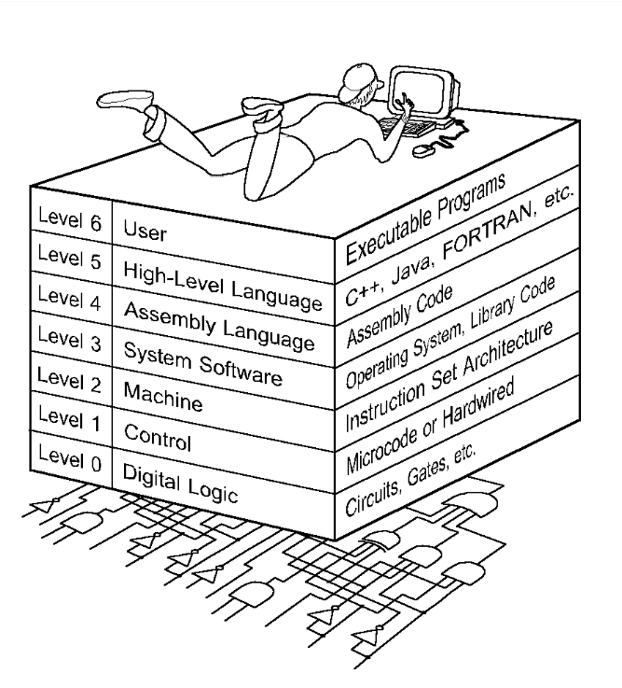

Slide 15
1.3 The Computer Level Hierarchy
Each virtual machine layer is an abstraction of the level below it.
The machines at each level execute their own particular instructions, calling upon machines at lower levels to perform tasks as required.
Computer circuits ultimately carry out the work.

Slide 16
1.3 The Computer Level Hierarchy
Level 6: The User Level
Program execution and user interface level.
The level with which we are most familiar.
Level 5: High-Level Language Level
The level with which we interact when we write programs in languages such as C, Pascal, Lisp, and Java.

Slide 17
1.3 The Computer Level Hierarchy
Level 4: Assembly Language Level
Acts upon assembly language produced from Level 5, as well as instructions programmed directly at this level.
Level 3: System Software Level
Controls executing processes on the system.
Protects system resources.
Assembly language instructions often pass through Level 3 without modification.

Slide 18
1.3 The Computer Level Hierarchy
Level 2: Machine Level
Also known as the Instruction Set Architecture (ISA) Level.
Consists of instructions that are particular to the architecture of the machine.
Programs written in machine language need no compilers, interpreters, or assemblers.

Slide 19
1.3 The Computer Level Hierarchy
Level 1: Control Level
A control unit decodes and executes instructions and moves data through the system.
Control units can be microprogrammed or hardwired.
A microprogram is a program written in a low-level language that is implemented by the hardware.
Hardwired control units consist of hardware that directly executes machine instructions.

Slide 20
1.3 The Computer Level Hierarchy
Level 0: Digital Logic Level
This level is where we find digital circuits (the chips).
Digital circuits consist of gates and wires.
These components implement the mathematical logic of all other levels.

Slide 21
Conclusion

